Slide 1
OBJECT DETECTION
Butterfly Learning

Slide 2
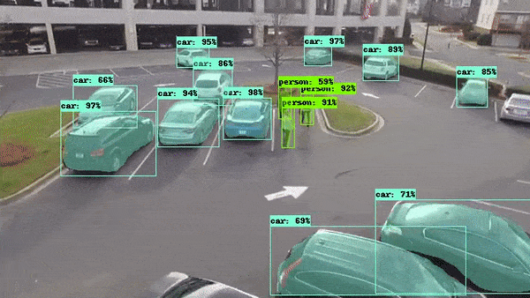
Course Introduction
Understanding Object Detection
HOG and Sift
Dalal and Trigs Detector
DPM
Over feat network
Selective search
Edge boxes
RCNN
Special pyramid network
Fast RCNN
Faster RCNN
YOLO
SSD
Mask RCN
Detectron
Classical Approaches
CNN + Classical Based Region Proposal Paradigm
CNN Based Single Shot Paradigm
Image Segmentation
Butterfly Learning

Slide 3

Course Prerequisite
Python: General Programing
CNN : Image Classification Basics
Simple Mathematics
Teaching Methodology
Try to go into depth of each of the techniques in intuitive way rather than only showing mathematical aspects.
We will try to reasoning each of the technique such a way we can understand why that technique come into first place.
How object detection has evolved over time.
Butterfly Learning

Slide 4
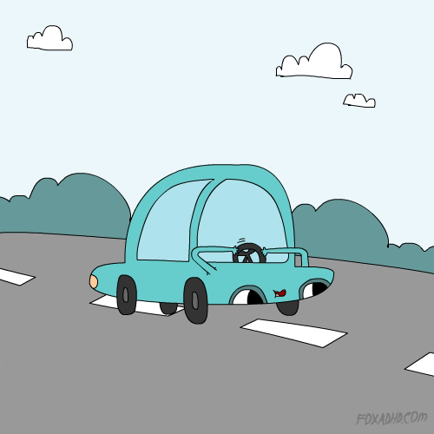
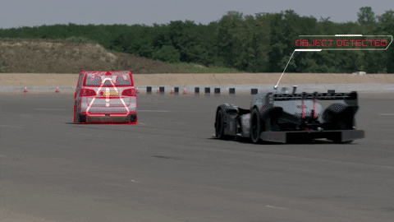
Applications of Object Detection
1. Self driving car
Image Credit: https://giphy.com/
Butterfly Learning

Slide 5
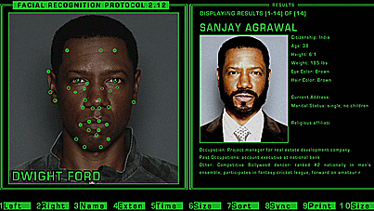
Applications of Object Detection
1. Self driving car
2. Face detection and recognition
Image Credit: https://giphy.com/
Butterfly Learning

Slide 6
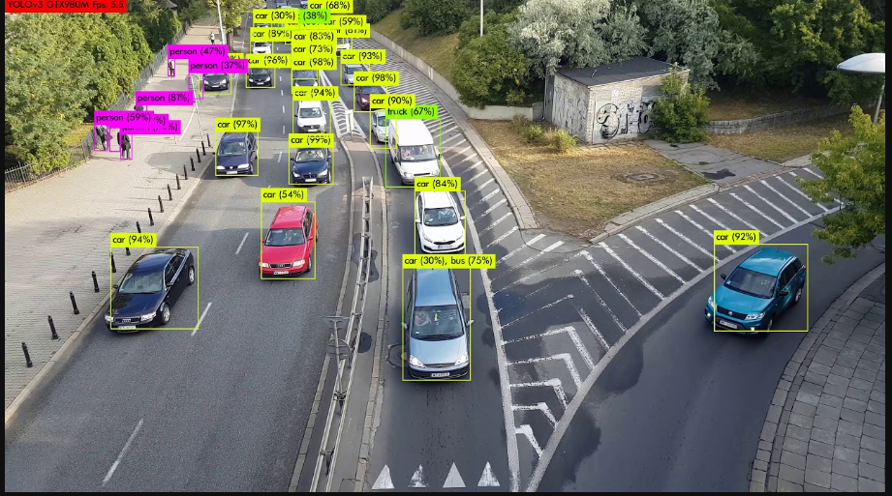
Applications of Object Detection
1. Self driving car
2. Face detection and recognition
3. Traffic Detection
Image Credit: https://www.youtube.com/watch?v=lekdUXv82xQ
Butterfly Learning

Slide 7
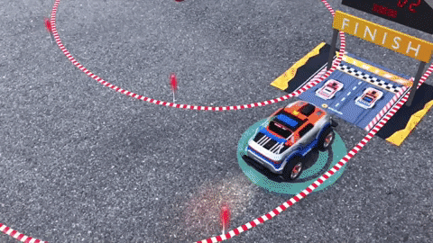
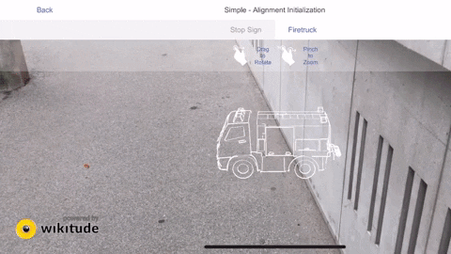
Applications of Object Detection
1. Self driving car
2. Face detection and recognition
3. Traffic Detection
4. Tracking Objects
Image Credit: https://giphy.com/
Butterfly Learning

Slide 8
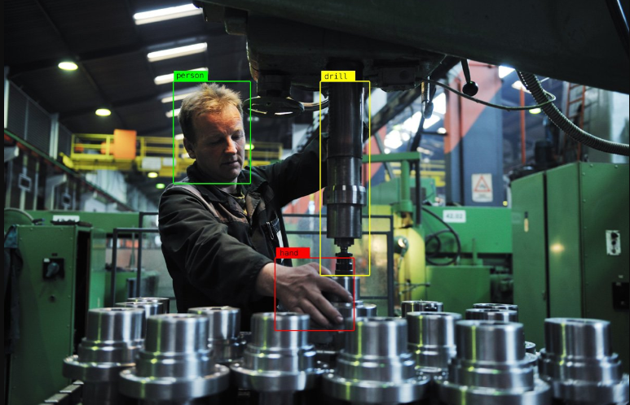
Applications of Object Detection
1. Self driving car
2. Face detection and recognition
3. Traffic Detection
4. Tracking Objects
5. Manufacturing industry
Image Credit: https://learn.alwaysai.co/object-detection
Butterfly Learning

Slide 9
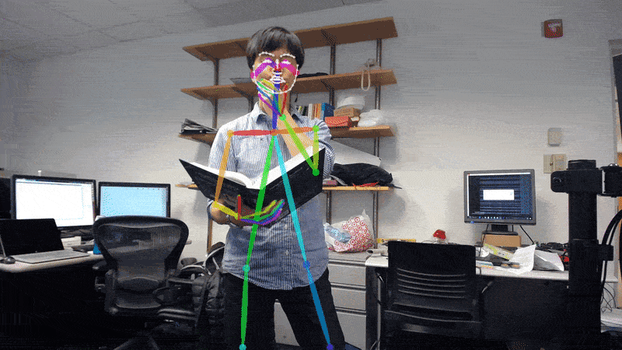
Applications of Object Detection
1. Self driving car
2. Face detection and recognition
3. Traffic Detection
4. Tracking Objects
5. Manufacturing industry
6. Pose Detection or Key point Detection
7. Counting objects
8. Video surveillance and many more..
Image Credit: https://giphy.com/
Butterfly Learning

Slide 10
Projects: End to End
Covid Mask Detection + Distance measurement system
Car Game Object Detection
Student Attendance System
General Object Detection in public
Airbnb’s Amenity Detection
Case Study

